Slide 1
MGB210 MONITORING AND MANAGING OPERATIONAL PEREFORMANCE
Topic 12 Lean Systems
Chapters 14:
Stevenson, W.J. (2021) 14th ed. Operations Management, McGraw Hill, New York, NY.
Chapters 16
Russell, Roberta S., and Taylor III, Bernard W. (2017) Operations management: Creating value along the supply chain, 9th ed., Hoboken: NJ.

Slide 2
Lecture Outline
Lean Production and JIT (Definition)
Basic elements of Lean Production
Benefits of Lean Production
Implementing Lean Production
Lean Services
Leaning the Supply Chain
Lean Six Sigma

Slide 3
Lean production – defined:
An integrated management system that emphasizes the elimination of waste and the continuous improvement of operations (Russell and Taylor, 2014, p.723)
A flexible system that uses minimal resources and produced high quality goods and services (Stevenson, 2021, p.612)
Just in time (JIT) – smoothing the flow of material to arrive just as it is needed (Russell and Taylor, 2014, p.723).
Eg Zara

Slide 4
Lean System Principles
Five principles embody the way lean systems function:
Identify customer values
Focus on processes that create value
Eliminate waste to create “flow”
Produce only according to customer demand
Strive for perfection
Copyright ©2021 McGraw-Hill Education. All rights reserved. No reproduction or distribution without the prior written consent of McGraw-Hill Education.
14-4

Slide 5
Benefits & Risks of Lean Systems
Key benefits
Reduced waste
Lower costs
Increased quality
Reduced cycle time
Increased flexibility
Increased productivity
Critical risks
Increased stress on workers
Fewer resources available if problems occur
Supply chain disruptions can halt operations
Copyright ©2021 McGraw-Hill Education. All rights reserved. No reproduction or distribution without the prior written consent of McGraw-Hill Education.
14-5

Slide 6
Lean Operations: The Beginning
Lean operations began as lean manufacturing, also known as JIT, in the mid-1900s
Developed by Taiichi Ohno and Shigeo Ohno of Toyota
Focus was on eliminating all waste from every aspect of the process
Waste is viewed as anything that interferes with, or does not add value to, the process of producing automobiles
Many terms used by Toyota, such as Kanban, Kaizen, and Muda, are commonly used industry wide.
Copyright ©2021 McGraw-Hill Education. All rights reserved. No reproduction or distribution without the prior written consent of McGraw-Hill Education.
14-6

Slide 7
Basic Elements of Lean Production
Doing more with less inventory, fewer workers, less space
Just-in-time (JIT)
smoothing the flow of material to arrive just as it is needed
“JIT” and “Lean Production” are used interchangeably
Muda
waste, anything other than that which adds value to product or service

Slide 8
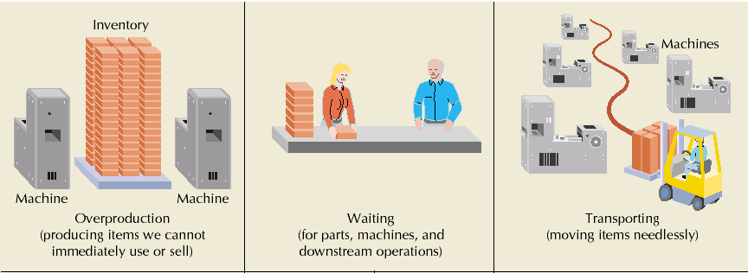
Waste in Operations
8

Slide 9
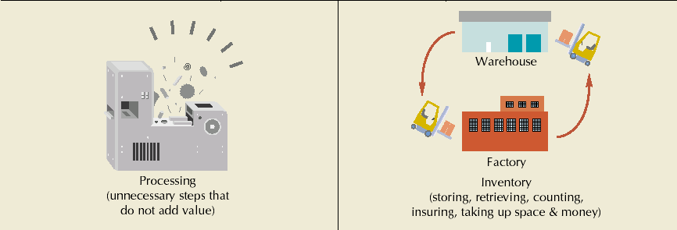
Waste in Operations
9

Slide 10
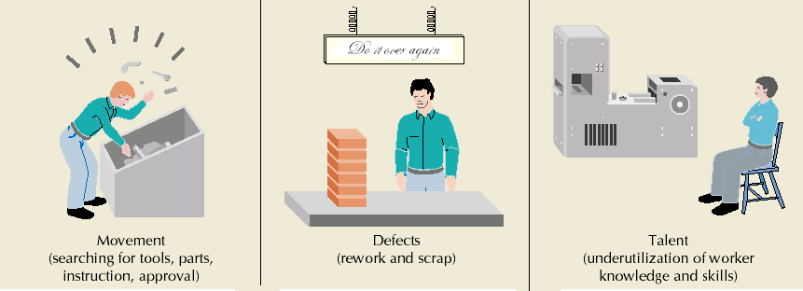
Waste in Operations
10

Slide 11
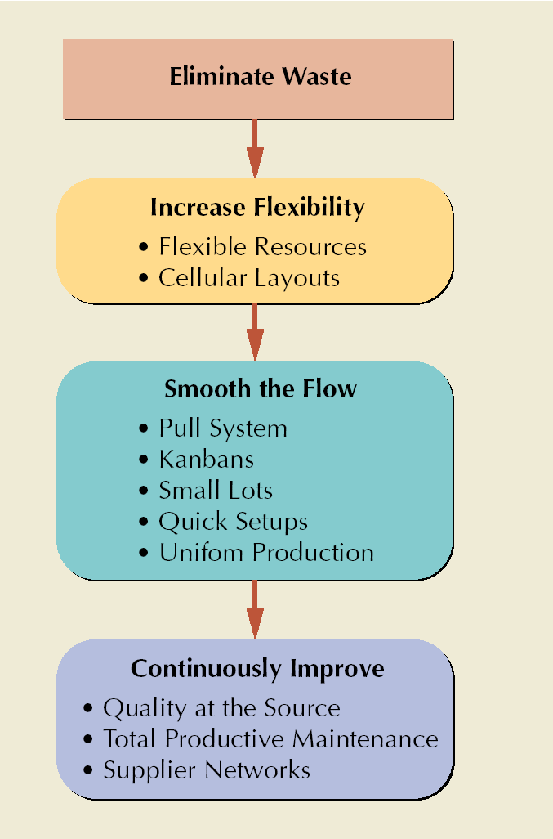
Basic Elements
Flexible resources
Cellular layouts
Pull system
Kanbans
Small lots
Quick setups
Uniform production levels
Quality at the source
Total productive maintenance
Supplier networks

Slide 12
Flexible Resources
Multifunctional workers
perform more than one job
general-purpose machines perform several basic functions
Cycle time
time required for the worker to complete one pass through the operations assigned
Takt time
paces production to match the rate customer demand
12

Slide 13
Cellular Layouts
Manufacturing cells
comprised of dissimilar machines brought together to manufacture a family of parts
Cycle time is adjusted to match takt time by changing worker paths
13

Slide 14
Pull System
Material is pulled through the system when needed
Reversal of traditional push system where material is pushed according to a schedule
Forces cooperation
Prevent over and underproduction
While push systems rely on a predetermined schedule, pull systems rely on customer requests
14

Slide 15
Kanbans
Card which indicates standard quantity of production
Derived from two-bin inventory system
Maintain discipline of pull production
Authorize production and movement of goods
15

Slide 16
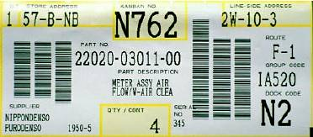
Sample Kanban
16

Slide 17
Origin of Kanban
a) Two-bin inventory system b) Kanban inventory system
Bin 1
Kanban
Bin 2
Reorder
card
Q - R
R
R
Q = order quantity
R = reorder point - demand during lead time
17

Slide 18
Types of Kanban
Production kanban
authorizes production of goods
Withdrawal kanban
authorizes movement of goods
Kanban square
a marked area designated to hold items
Signal kanban
a triangular kanban used to signal production at the previous workstation
Material kanban
used to order material in advance of a process
Supplier kanban
rotates between the factory and suppliers
18

Slide 19
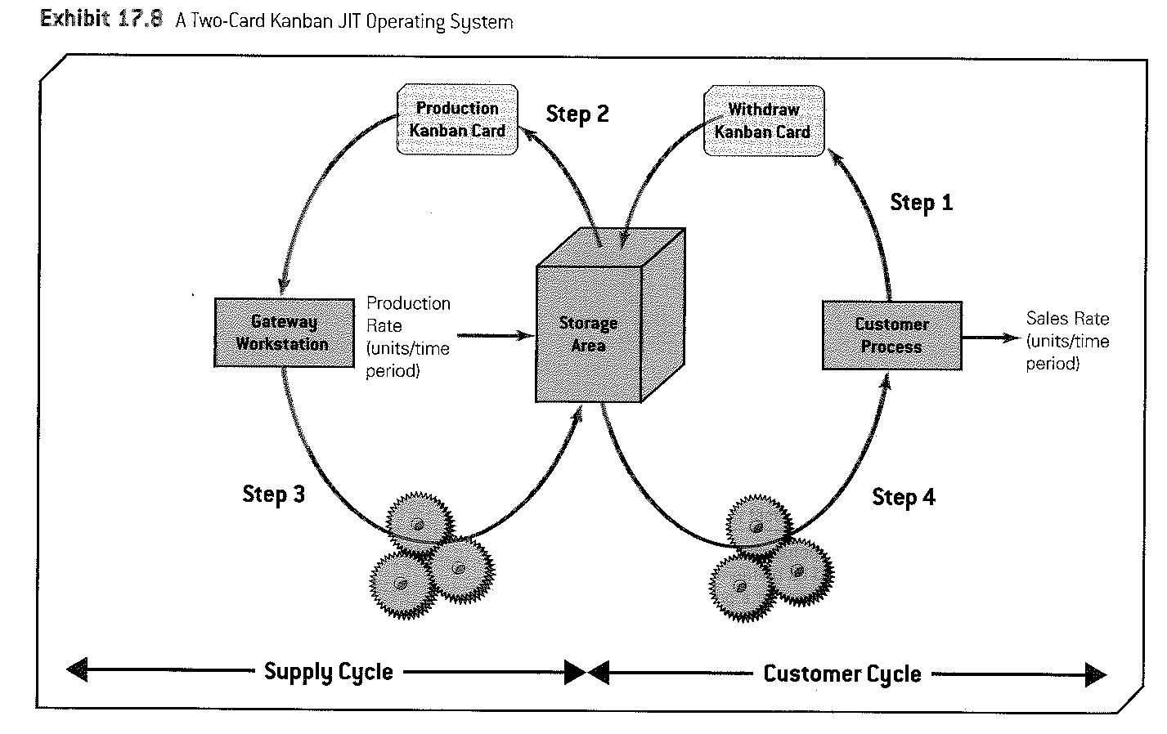
Product: Just in Time Inventory (JIT) -Kanban
(Collier & Evans, 2007, p. 754; Russell & Taylor, 2011 , pp. 726-730)
19

Slide 20
Small Lots
Require less space and capital investment
Move processes closer together
Make quality problems easier to detect
Make processes more dependent on each other
20

Slide 21
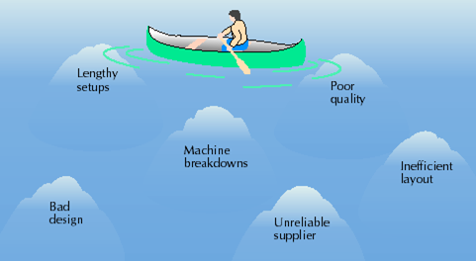
Inventory Hides Problems
21

Slide 22
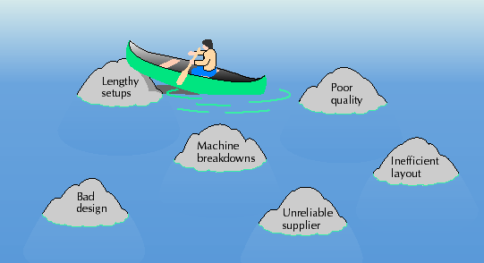
Less Inventory Exposes Problems
22

Slide 23
Quick Setups
Internal setup
Can be performed only when a process is stopped
External setup
Can be performed in advance
SMED* Principles
Separate internal setup from external setup
Convert internal setup to external setup
Streamline all aspects of setup
Perform setup activities in parallel or eliminate them entirely
* Single Minute Exchange of Die; Quick Changeover
23

Slide 24
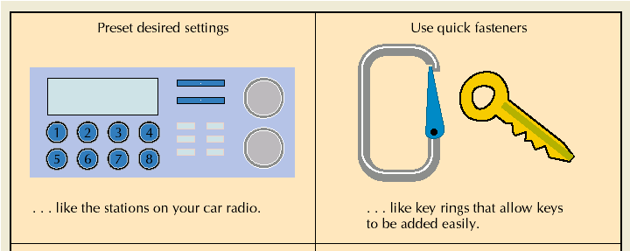
Techniques for Reducing Setup Time
24

Slide 25
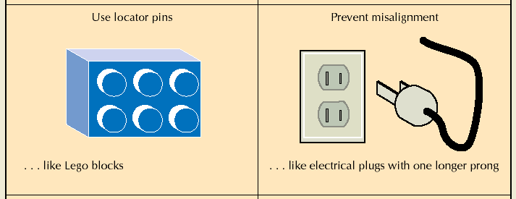
Techniques for Reducing Setup Time
25

Slide 26
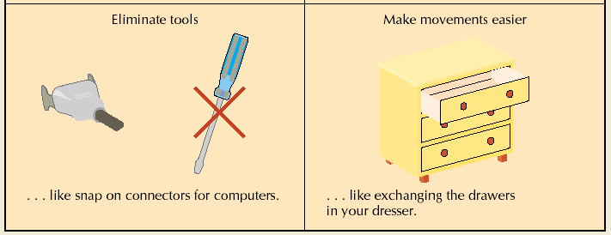
Techniques for Reducing Setup Time
26

Slide 27
Uniform Production Levels
Result from smoothing production requirements on final assembly line
Kanban systems can handle +/- 10% demand changes
Reduce variability with more accurate forecasts
Smooth demand across planning horizon
Mixed-model assembly steadies component production
27

Slide 28
Quality at the Source
Visual control
makes problems visible
Poka-yokes
prevent defects from occurring
Kaizen
a system of continuous improvement; “change for the good of all”
Jidoka
authority to stop the production line
Andons
call lights that signal quality problems
Under-capacity scheduling
leaves time for planning, problem solving, and maintenance
28

Slide 29
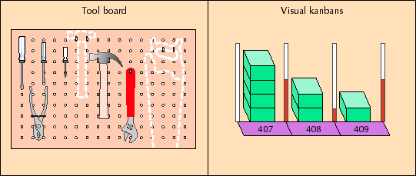
Examples of Visual Control
29

Slide 30
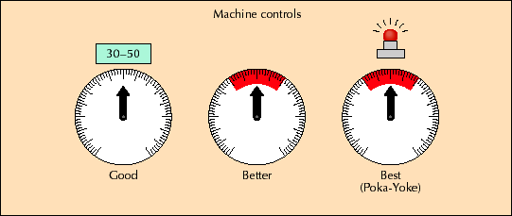
Examples of Visual Control
30

Slide 31
5 Whys
A key part in an effective Kaizen is finding the root cause of a problem and eliminating it
A practice of asking “why?” repeatedly until the underlying cause is identified (usually requiring five questions)
Simple, yet powerful technique for finding the root cause of a problem
31

Slide 32
5S Workplace Scan
5S Scan
Goal
Eliminate or Correct
Seiri
(sort)
Seiton
(set in order)
Seisou
(shine)
Keep only what you need
A place for everything and everything in its place
Cleaning, and looking for ways to keep clean and organized
Unneeded equipment, tools, furniture; unneeded items on walls, bulletins; items blocking aisles or stacked in corners; unneeded inventory, supplies, parts; safety hazards
Items not in their correct places; correct places not obvious; aisles, workstations, & equipment locations not indicated; items not put away immediately after use
Floors, walls, stairs, equipment, & surfaces not clean; cleaning materials not easily accessible; lines, labels, signs broken or unclean; other cleaning problems
32

Slide 33
5S Workplace Scan
5S Scan
Goal
Eliminate or Correct
Seiketsu
(standardize)
Shisuke
(sustain)
Maintaining and monitoring the first three categories
Sticking to the rules
Necessary information not visible; standards not known; checklists missing; quantities and limits not easily recognizable; items can’t be located within 30 seconds
Number of workers without 5S training; number of daily 5S inspections not performed; number of personal items not stored; number of times job aids not available or up-to-date
33

Slide 34
Benefits of Lean Production
Reduced inventory
Improved quality
Lower costs
Reduced space requirements
Shorter lead time
Increased productivity

Slide 35
Benefits of Lean Production
Greater flexibility
Better relations with suppliers
Simplified scheduling and control activities
Increased capacity
Better use of human resources
More product variety
35

Slide 36
Implementing Lean Production
Use lean production to finely tune an operating system
Somewhat different between countries (USA, Aus v Japan)
Lean production is still evolving
Lean production is not for everyone

Slide 37
Lean Production Problems
Highly variable demand
Large variety of low-volume products
Custom engineered products
Mass production parts
Unexpected changes in demand or supply

Slide 38
Lean Services
Basic elements of lean production apply equally to services
Most prevalent applications
lean retailing
lean banking
lean health care

Slide 39
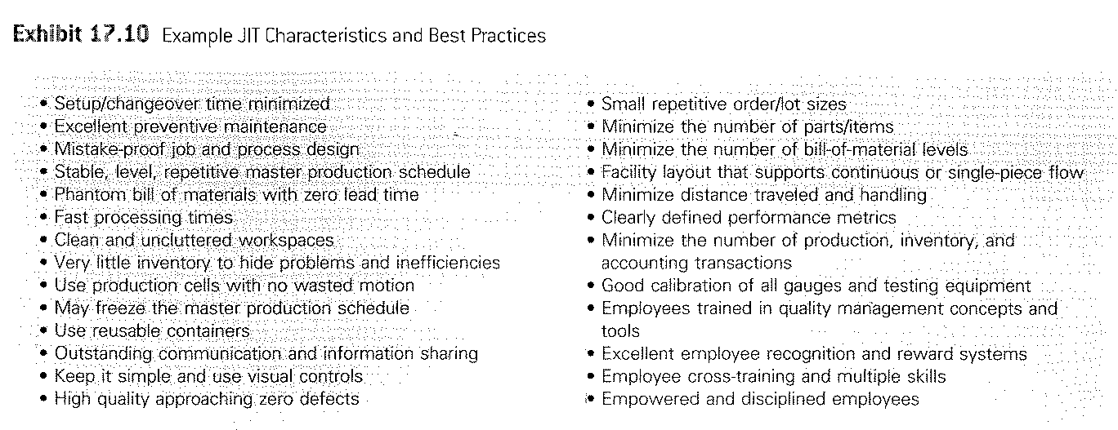
Reduce the cycle time in business processes to Increase the service level
How?
Services Lean Example: Swedish Hospital
39

Slide 40
Leaning the Supply Chain
Pull a smooth flow of material through the system
Build a highly collaborative business environment
Adopt the technology to support your system
Consider “near shoring”

Slide 41
Lean and Six Sigma are natural partners for process improvement
Lean
Eliminates waste and creates flow
More continuous improvement
Six Sigma
Reduces variability and enhances process capabilities
Requires breakthrough improvements

Slide 42
In the Lecture we covered:
JIT and Basic Elements of Lean Production
Benefits of Lean Production
Implementing Lean Production
Lean Services
Leaning the Supply Chain
Lean Six Sigma

